Slide 1

Age Prediction from Facial Images
Made By:
ABHI N SHAH (14BCE107)
RACHIT SHAH (14BCE110)

Slide 2
Preprocessing
Face Detection
Face Alignment
Resizing Face

Slide 3
DATASETS
CHALEARN LAP(LOOKING AT PEOPLE) DATASET (CVPR’16)
expanded version of a previous dataset (ICCV2015)
8000 images each with one face of a person.
Labels determined by multiple individuals using a Facebook collaborative survey and Amazon Mechanical Turk.
IMDB-WIKI DATASET
consists of approximately 500 thousand images (460723 from IMDband 62328 from Wikipedia).

Slide 4
Approach
Classification Problem of 101 classes
Transfer Learning with CNN pretrained architectures

Slide 5
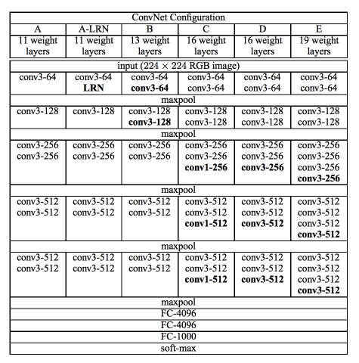
Model Architecture (VGG16)

Slide 6
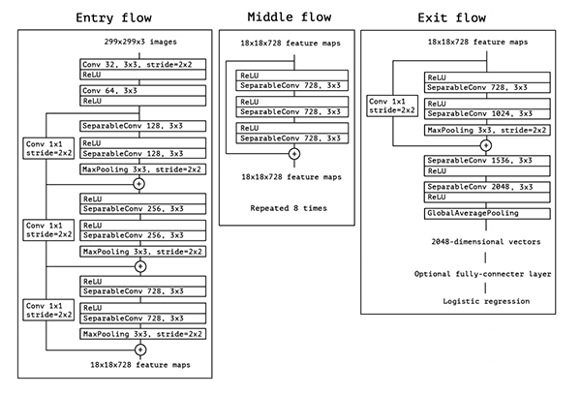
MoDEL ARCHITECTURE(XCEPTION)

Slide 7
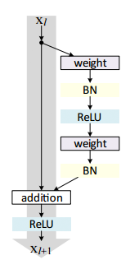
MODEL ARCHITECTURE(RESNET)

Slide 8
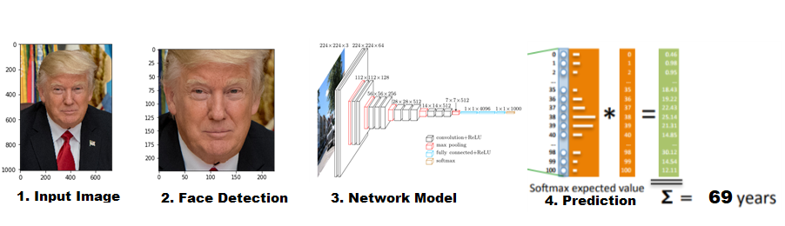
Project flow

Slide 9
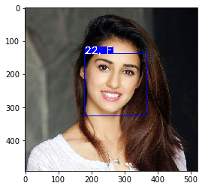
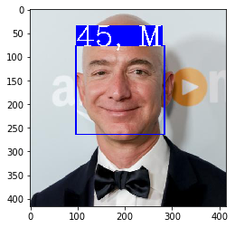
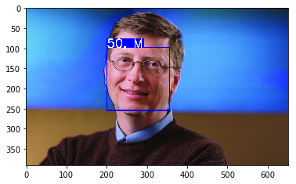
Sample Results

Slide 10
DEMO

